Slide 2
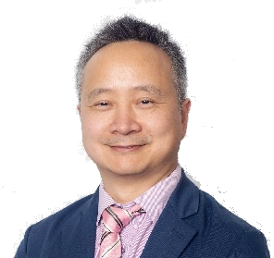
High level Dialogue
Xunpeng Shi
President, ISETS
Professor, University of Technoogy Sydney
Moderator

Slide 3
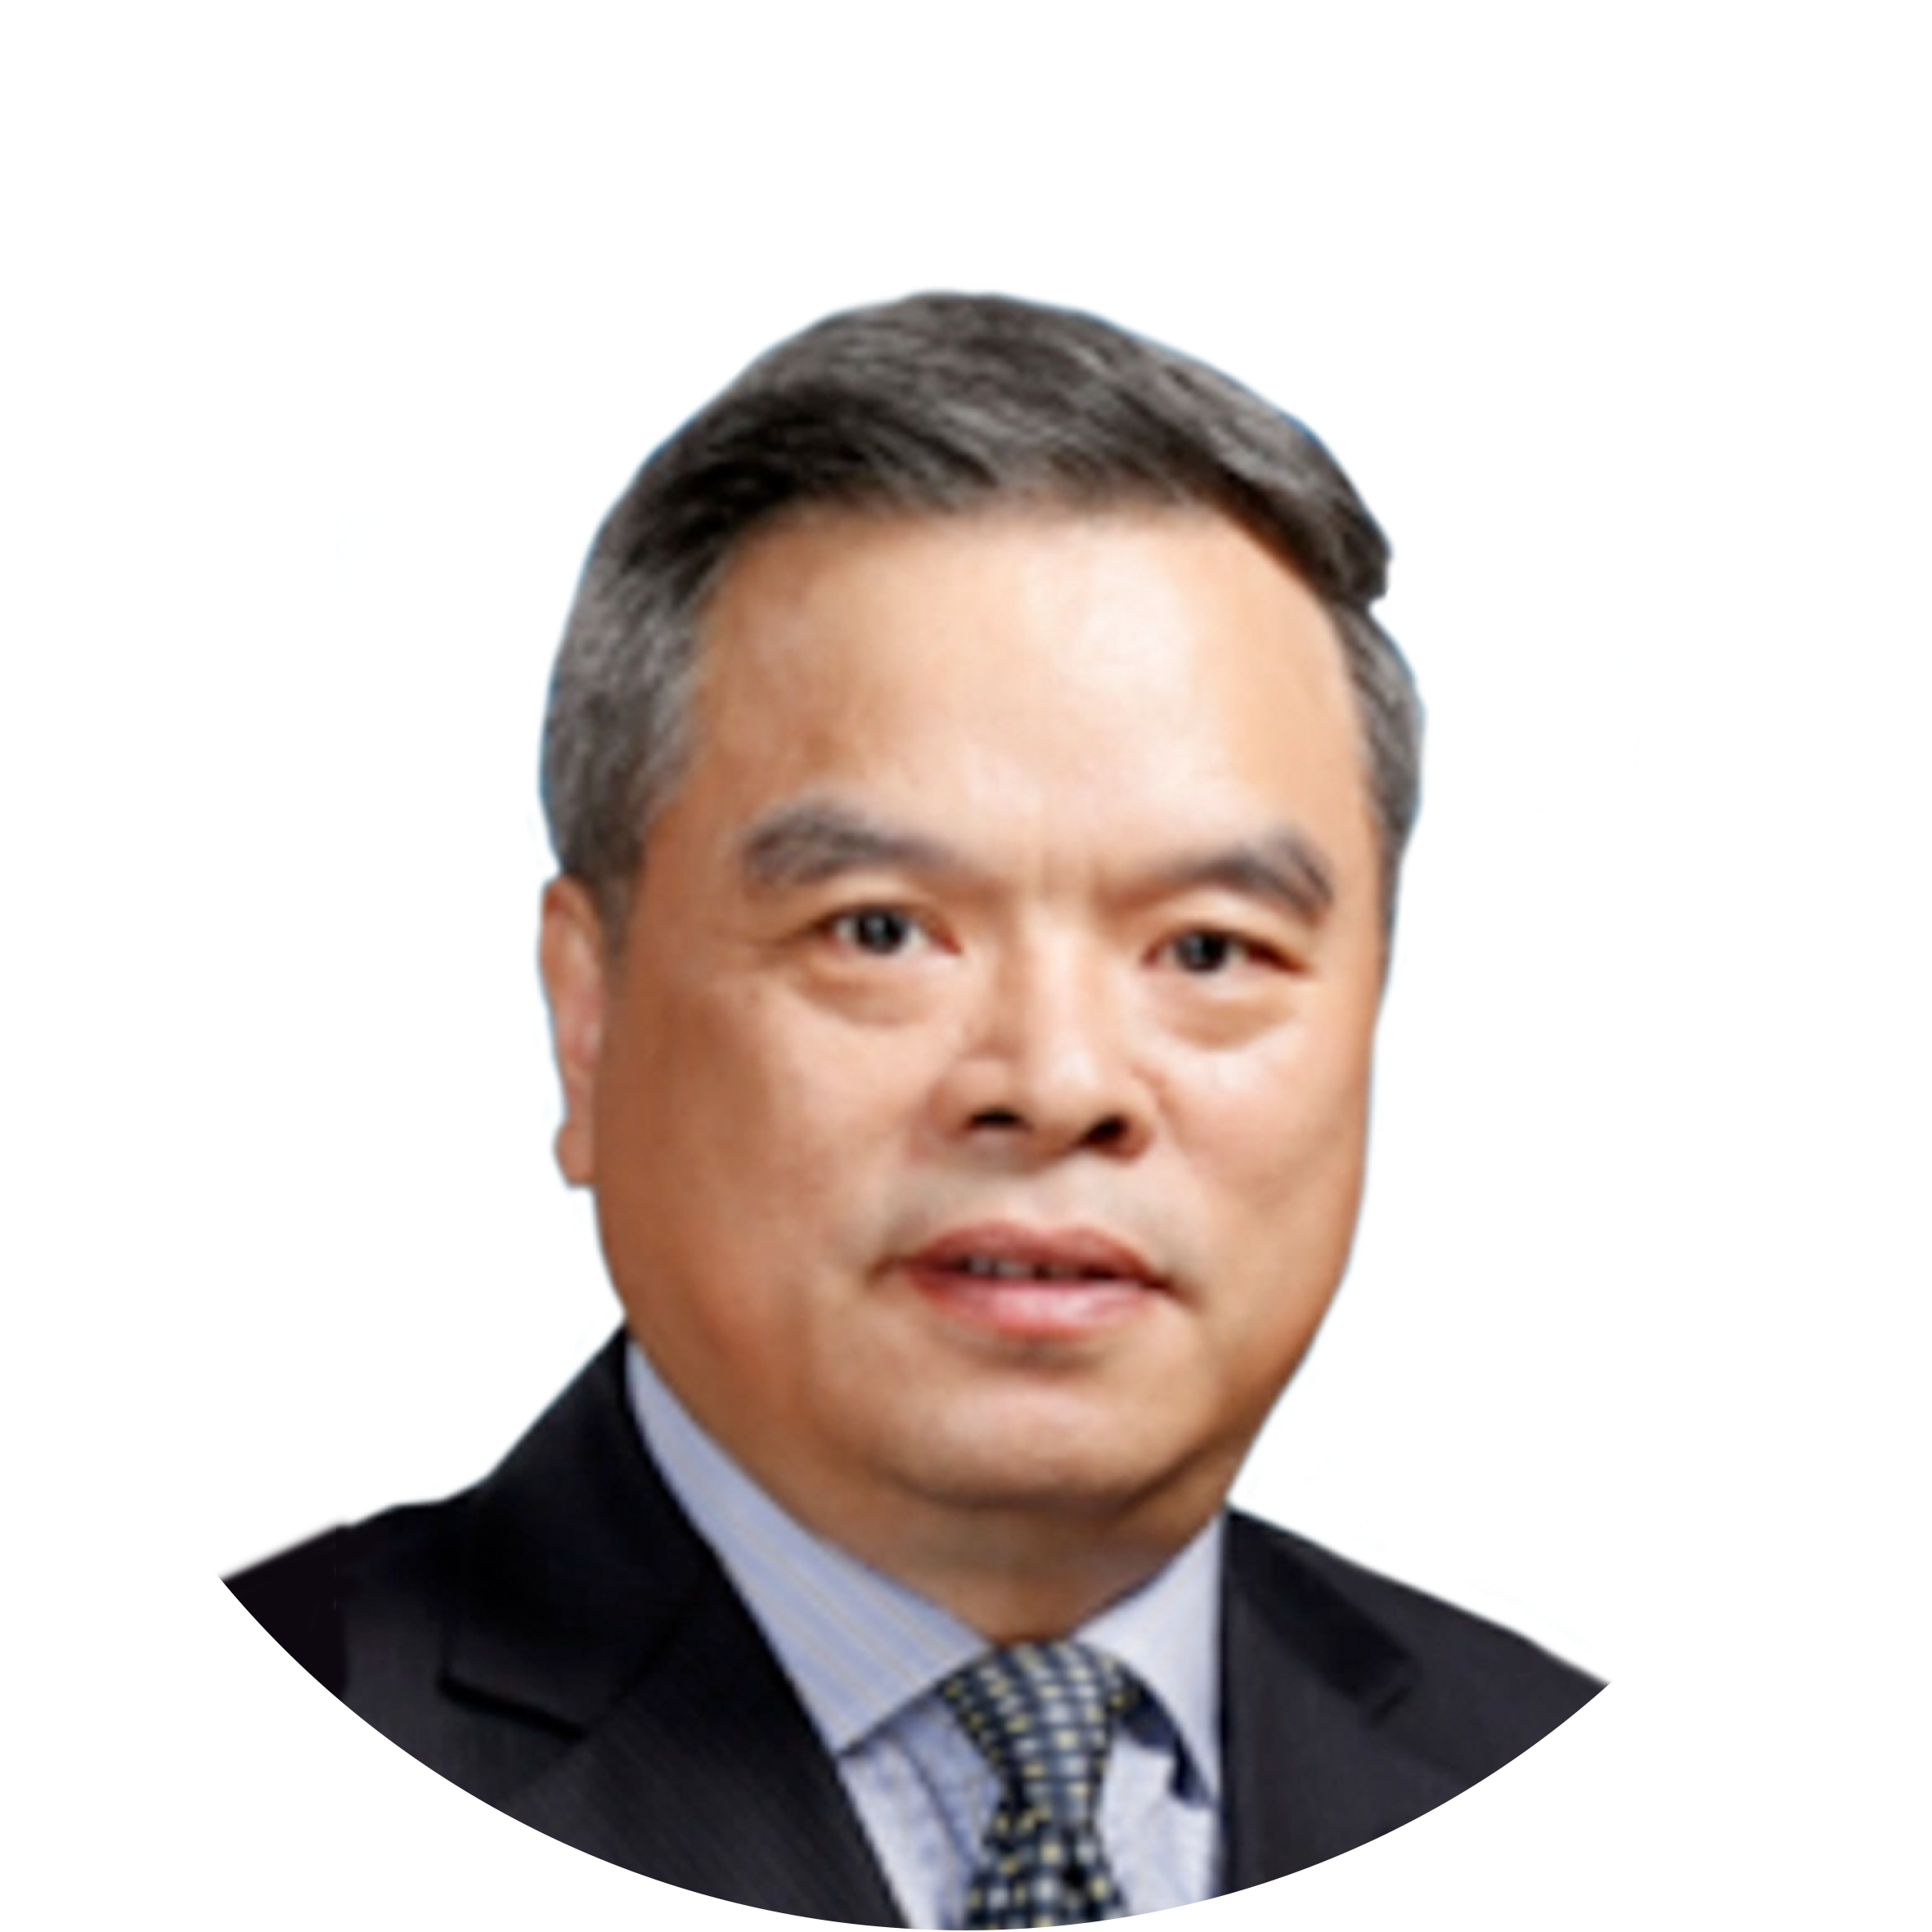
High level Dialogue
Liu Zehong
Executive Vice Chairman, GEIDCO

Slide 4
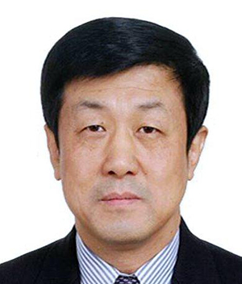
High level Dialogue
Sun Xiansheng
Council Chairman, ISETS

Slide 5
High level Dialogue
Weerawat Chantanakom
Councilor, Ministry of Energy of Thailand
Former Executive Director ACE

Slide 6
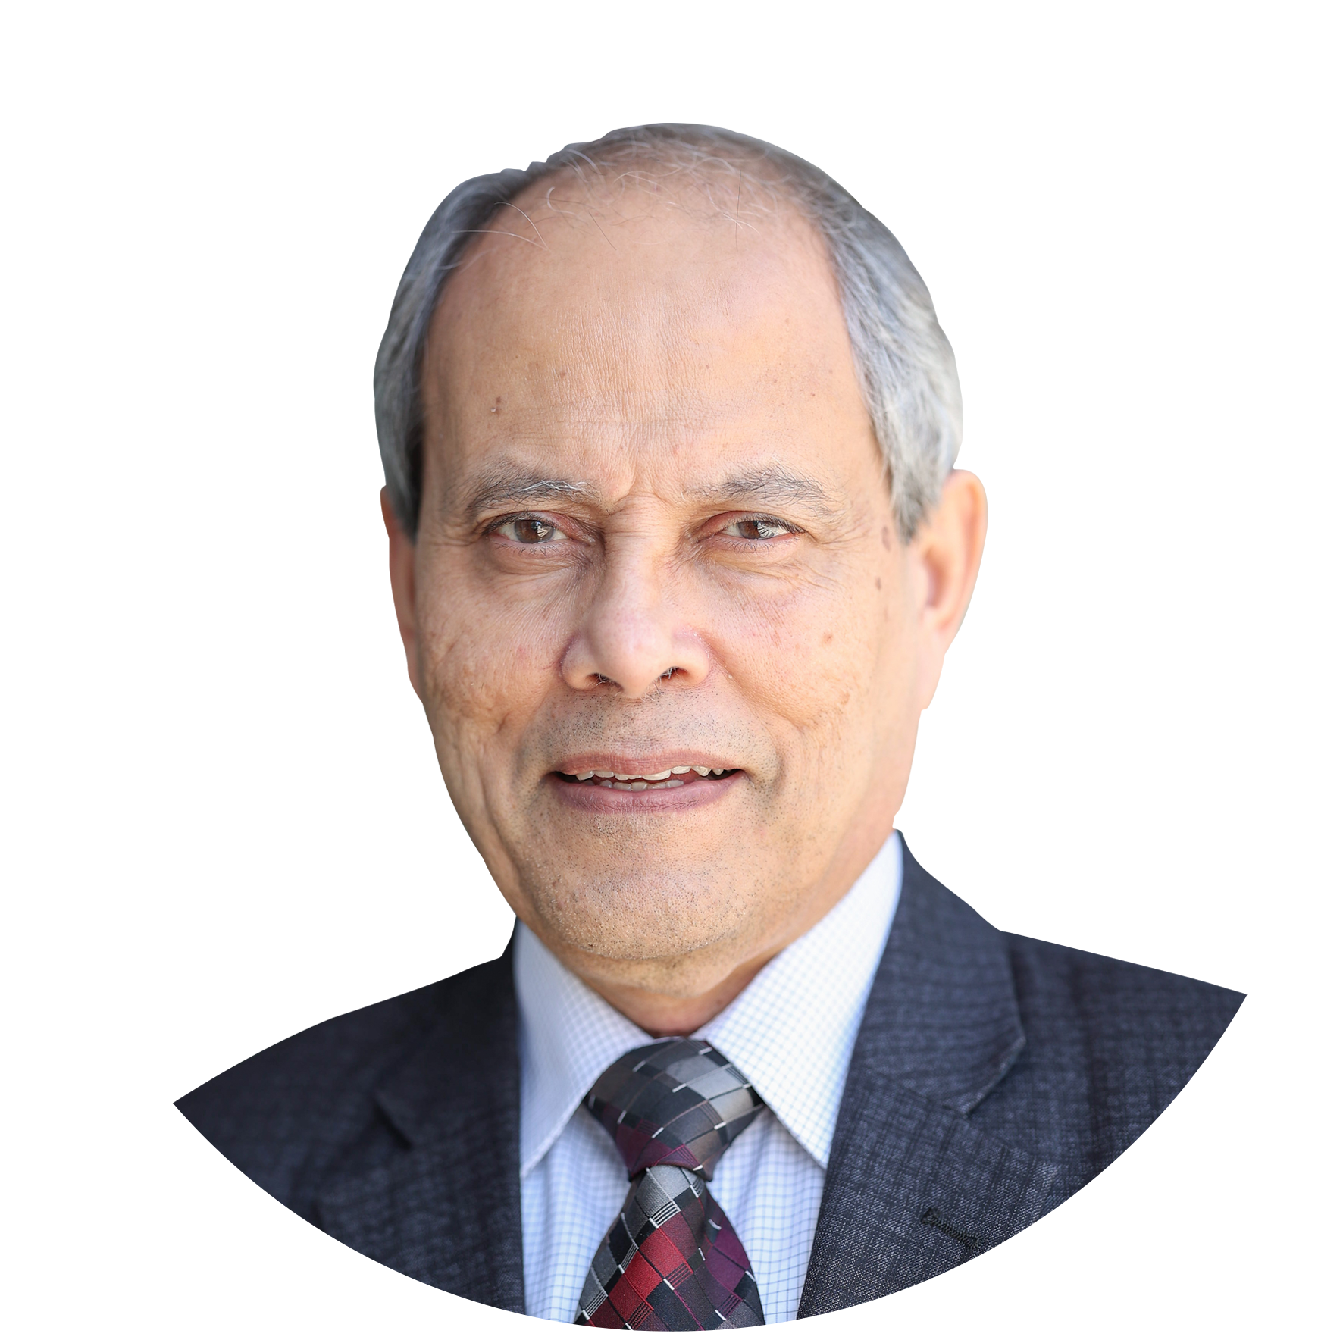
High level Dialogue
Saifur Rahman
2023 President & CEO, IEEE

Slide 7
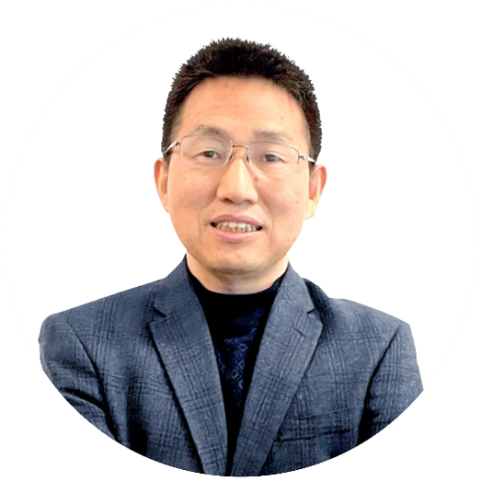
Release of Research Findings
Chen Gesong
Director General of Development Bureau
GEIDCO
Moderator

Slide 8
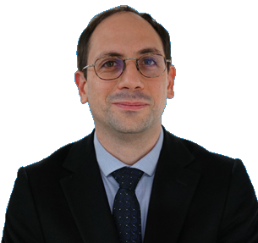
Release of Research Findings
Matthew Wittenstein
Chief of Section, Energy Division, UNESCAP

Slide 9
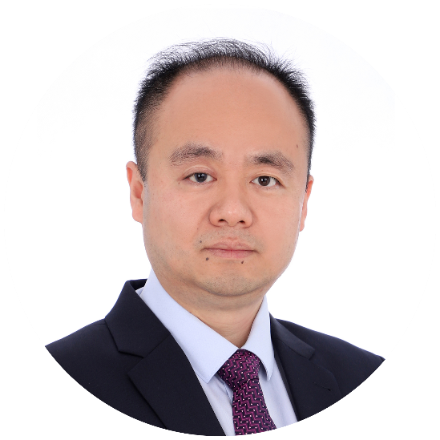
Release of Research Findings
Xiao Jinyu
Deputy Director General
Economic & Technology Research Institute,
GEIDCO

Slide 10
Keynote Speech
Chen Gesong
Director General of Development Bureau
GEIDCO
Moderator

Slide 11
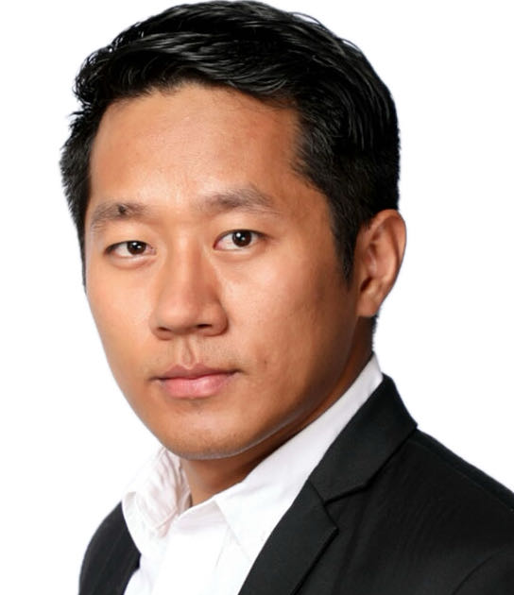
Keynote Speech
Hang Za Dal
Head of Climate and Energy, WWF Myanmar

Slide 12
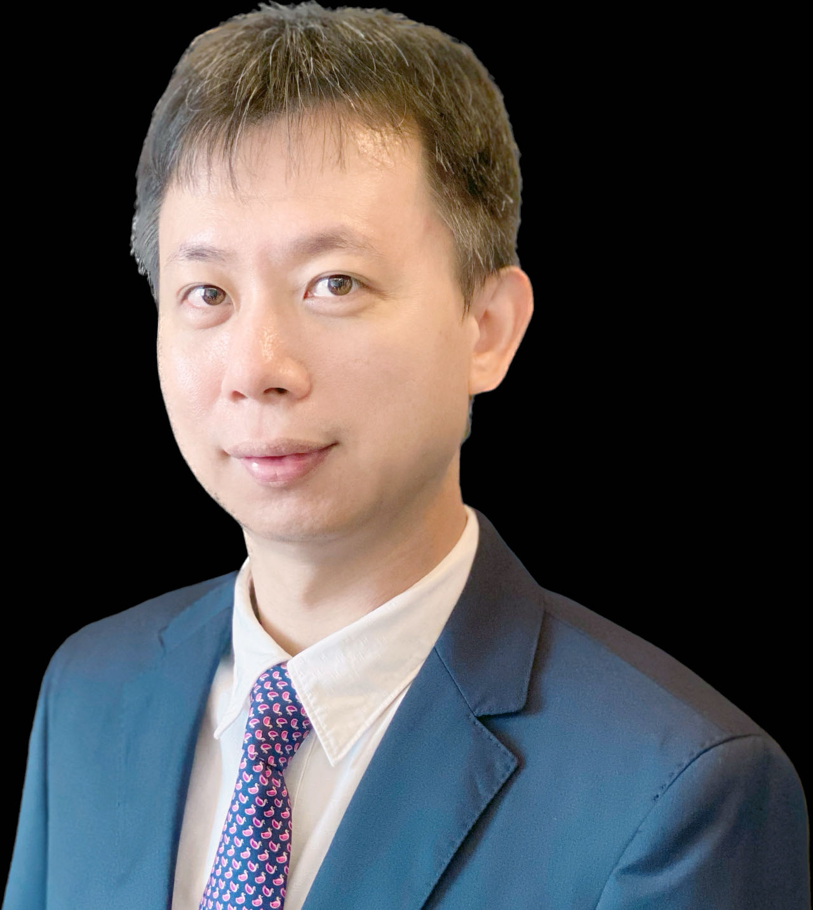
Keynote Speech
Victor Nian
Co-Founder and Chief Executive, CSER

Slide 13
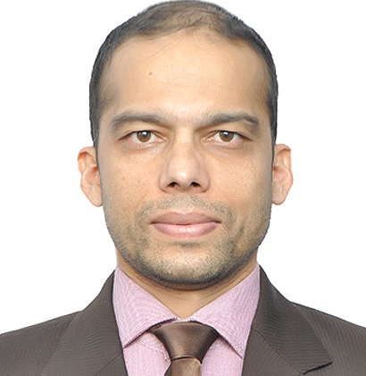
Keynote Speech
Tula Ram Poudel
Research fellow, SAARC Energy Centre

Slide 14
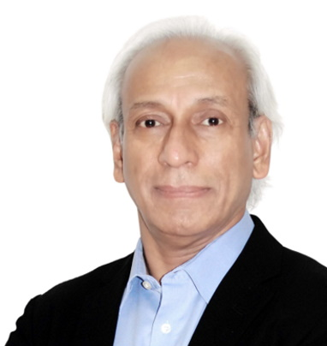
Keynote Speech
Reji Kumar Pillai
Chairman, Global Smart Energy Federation

Slide 15
Keynote Speech
Beni Suryadi
Manager, Policy Research and Analytics, ACE

