Slide 1
ASEAN Power Grid: Regional Integration for Energy Transition
Connecting a Net Zero Future: Grid Interconnection and Energy Collaboration in Asia Pacific
Bangkok, 17 October 2023
Beni Suryadi
E: benisuryadi@aseanenergy.org

Slide 2
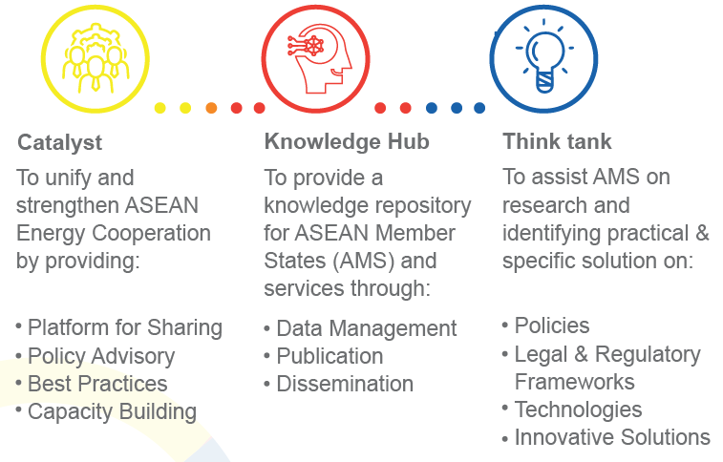

Slide 3
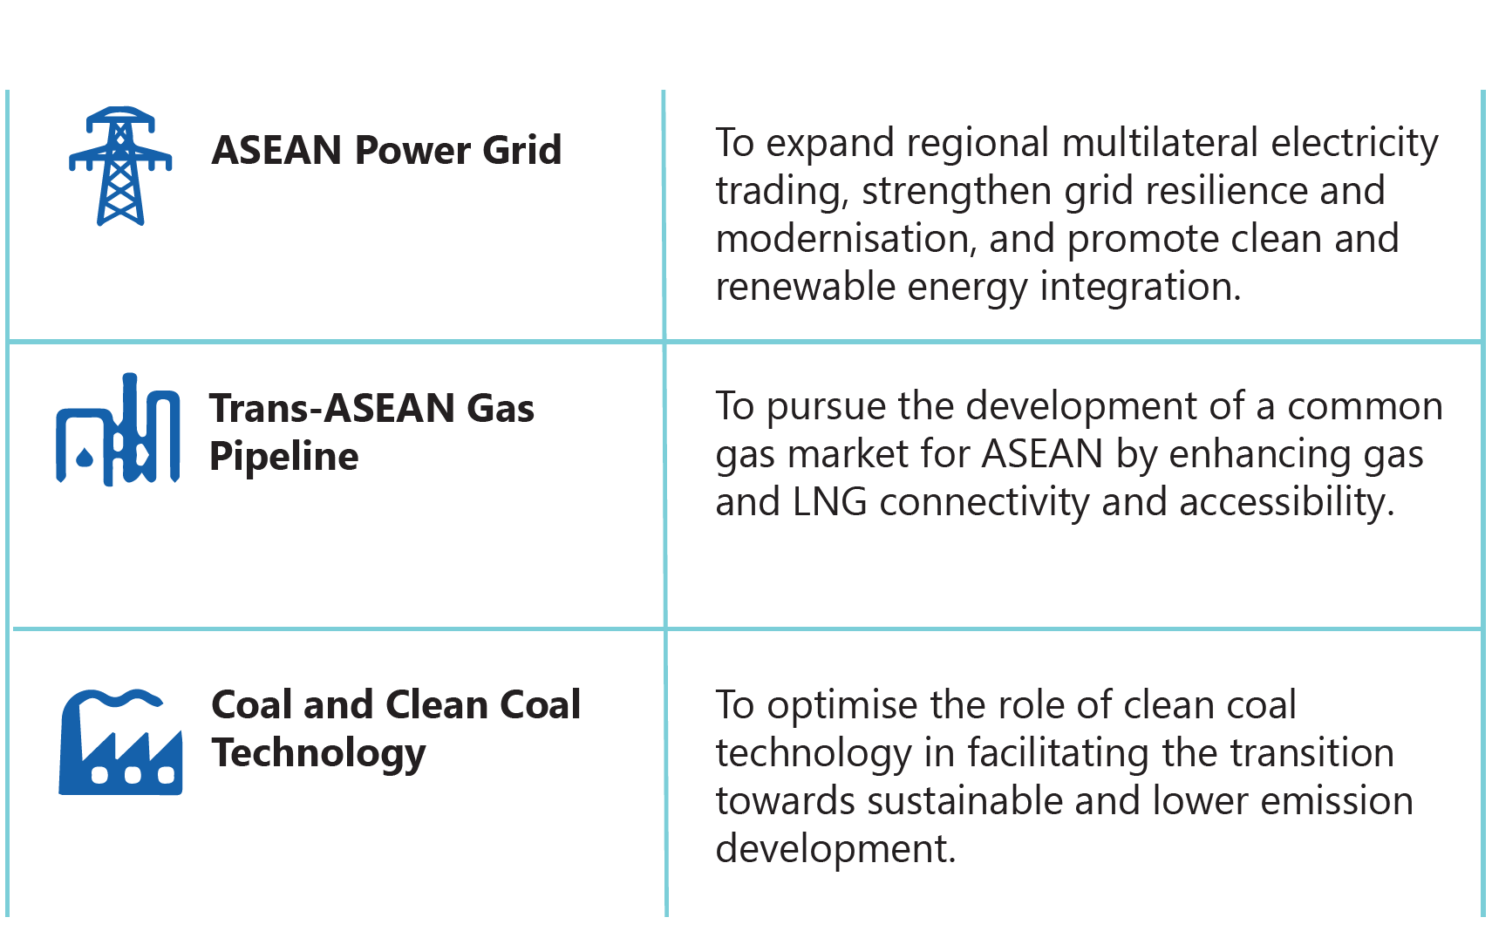
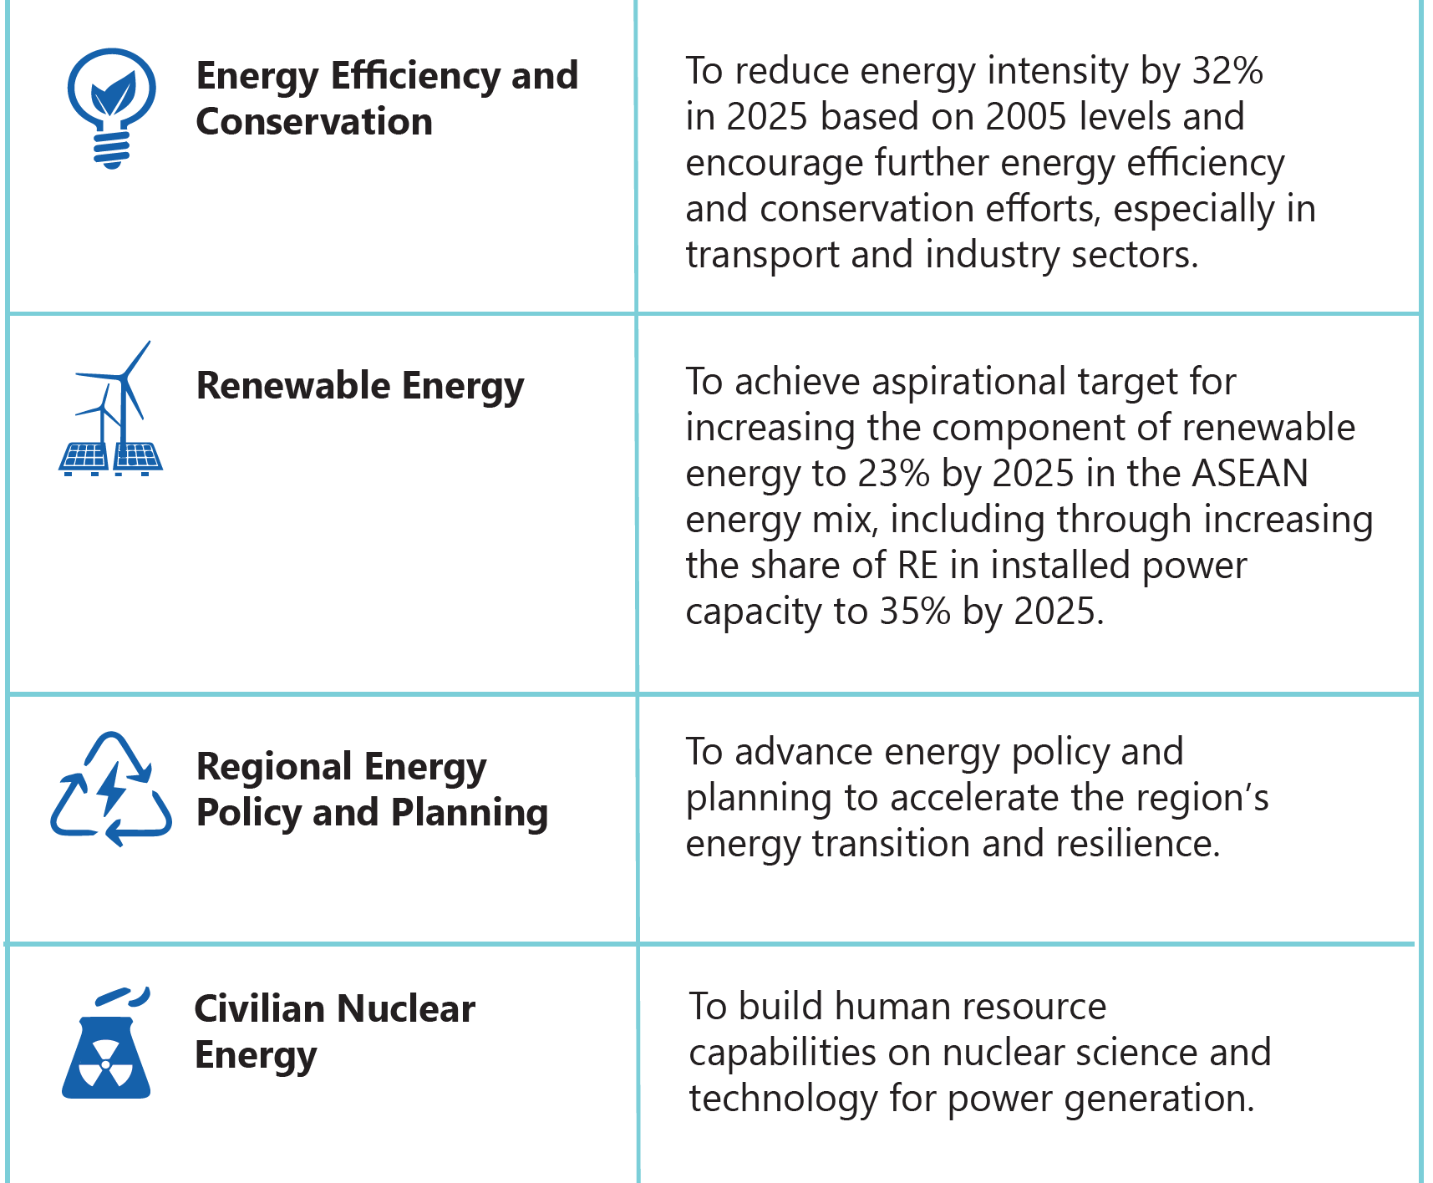
Regional blueprint for the energy cooperation in the ASEAN
ASEAN Plan of Action for Energy Cooperation (APAEC) 2016-2025 Phase 2: 2021-2025
Theme: “Enhancing Energy Connectivity and Market Integration in ASEAN to Achieve Energy Security, Accessibility, Affordability and Sustainability for All”.
Sub-theme: “Accelerating Energy Transition and Strengthening Energy Resilience through Greater Innovation and Cooperation.”

Slide 4
Regional Interconnections for Regional Integration

Slide 5
Regional Interconnections: ASEAN Power Grid – progress
Bilateral: 7,720 MW of existing cross-border interconnections and 555-625 MW on-going.
Multilateral: 265.73 GWh traded between Lao-Thailand-Malaysia-Singapore.

Slide 6
Regional Interconnections: ASEAN Power Grid – plan
ASEAN is planning 18 interconnectors projects and 62 vRE potential sites to advance the APG up until 2040.
Interconnection capacity by timeline under Updated PDP Scenario

Slide 7
Challenges and Opportunities
Challenge
Opportunities
Infrastructure
Utilization of existing interconnection
Build more interconnection
Market
Expanding bilateral power trade into multilateral and even regional power trading
Increasing Political Support for Interconnection
Pursuit of National Climate Target
Higher buy-in from AMS utility to interconnect.
ASEAN members increase its commitment to energy transition as seen in the updated PDP.
AMS limitations, such as land and competitive price could be seen as an opportunity
Increasing regional energy security → to lower cost & avoid energy price shock
Economic potential for domestic power supply manufacturing
Technical
Financial
Regulatory & Institutional
Harmonized grid codes and interconnection standards
Lack of participation of private investment
Political requirements
Governance of expanding to MPT
High capital of grid investment
MPT playbook & institutional set up for enabling MPT
Barriers

Slide 8
