Slide 1
INTERNATIONAL SOCIETY FOR ENERGY TRANSITION STUDIES (ISETS)
Inaugural International Conference on
ENERGY TRANSITION AMID UNPRECIDENTED CHANGES
15-19 October 2023, Bangkok
ENERGY TRANSITION AND GRID MODERNIZATION – Case Study of the Indian Power System
Reji Kumaar Pillai
Chairman – Global Smart Energy Federation
President – India Smart Grid Forum

Slide 2
GSEF INTRODUCTION
Established in 2010, registered as a 501(c)(3) non profit corporation in Washington D.C. as Global Smart Grid Federation (GSGF); changed the name to Global Smart Energy Federation (GSEF) in 2020
Global stakeholder organization committed to create smarter, cleaner electrical and transportation systems around the world
Comprised of national smart grid and smart energy associations, leading utilities, academia and think tanks from 5 continents
Brings together the intellectual capital of smart energy stakeholder organizations from around the globe
More on GSEF at www.globalsmartenergy.org

Slide 3
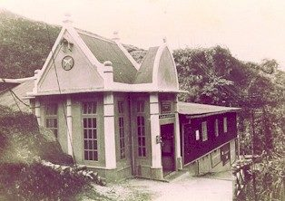
India’s Tryst with Electrification
1898: 130 kW Sidrapong hydroelectric power station in Darjeeling in a tea estate
1899: 1 MW thermal plant in Kolkata
1902: Electric Trams in Kolkata

Slide 4
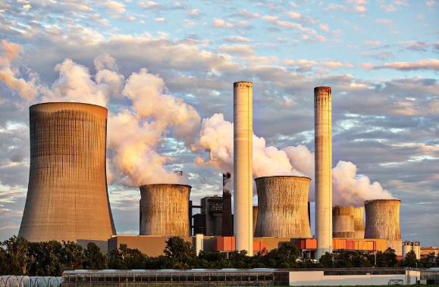
India’s Installed Capacity
Generation Capacity
1947: 1.36 GW
2023: 424 GW (>300X in 75 Yrs!)
Per Capita Consumption
1947: 16.3 kWh
2022: 1400 kWh
Installed Power Generation Capacity (Source-wise) in GW
Thermal (Coal, Gas and Diesel) | Hydro | Solar | Wind | Nuclear | Other | Total Non-Fossil | Grand Total
238.44 | 46.85 | 71.61 | 44.08 | 7.48 | 15.82 | 185.84 | 424.28
56.19 | 11.04 | 16.88 | 10.39 | 1.77 | 3.73 | 43.8 | 100%

Slide 5
One Nation – One Grid (1/2)
3rd
India has the 3rd largest power system in the world
Modern Transmission System
800 kV & 500 kV HVDC lines
765 kV & 400 kV AC lines
Modern Control Centers
Electrification
619,000 villages and 99.9% households electrified
27 million households electrified in 18 months (Nov 2017 to March 2019) through a focused mission
424 GW, 300 million customers
One Grid covering >3 million Sqkm operating in one frequency

Slide 6
One Nation – One Grid (2/2)
Indian Power System is operated as 5 regional grids with separate control centers – Regional Load Dispatch Centers (RLDCs)
National Control Centre (NLDC) integrates all 5 Regions (RLDC)
Independent System Operator (GRID CONTROLLER OF INDIA LTD) manages the RLDCs and NLDCs
All states have State Load Dispatch Centers (SLDCs) managed by respective state transmission companies
2000 + PMUs installed on the EHV grid
All regions are interconnected and operates in ONE FREQUENCY
11 Renewable Energy Management Centers (REMCs) with Advanced Tools for Weather and RE Generation Forecasting – 7 being added
Matured power markets with 3 functional power exchanges
Renewable Purchase Obligations (RPO) for Utilities
Real-Time Market operational since June 2020
Green Term Ahead Market (GTAM) launched in 2021
Green Energy Open Access Rules in 2022 (open access for customers with >100kW demand)
Carbon Market will be launched by end of 2023
Power Trading with Nepal, Bhutan and Bangladesh
One Nation – One Grid

Slide 7
Grid Modernization Initiatives in India
India is the only country amongst major economies that achieved the target under Paris Climate Agreement of 40% power generation capacity from non-fossil fuels by 2030 in 2022 – 8 years ahead!
New Target: 500 GW Renewable Energy (RE) capacity by 2030
Smart Grid Initiatives in India
Smart Grid Vision and Roadmap in 2013 (formulated by ISGF, adopted by Ministry of Power)
14 Smart Grid Pilot Projects allotted in 2013 – 50% project cost by Govt of India
National Standards for Smart Meters (IS:16444/IS:15959) in 2015/2017
EVSE Standards: IS 17017 series; 12 standards issued, rest under progress
Net Metering: All States and Union Territories issued net metering policies between 2013 and 2016
Energy Storage Systems Roadmap for India prepared by ISGF in 2019 - cumulative capacity estimated by 2032 is 2416 GWh of which 209 GWh is for grid support
250 Million Smart Meters presently under rollout on fast track on innovative business model – 15% capex by Govt of India as grant; rest as monthly fee (Opex): $xx per meter per month for 93 months
Open Access for RE for all customers with demand >100 kW
Time of Day or variable tariff for all customers from April 2025 – upto 20% rebate during high solar hours; and up to 20% surcharge during peak hours

Slide 8
Major Success Stories
Solar and Wind
Projects allotted through transparent auctions brought prices to 3 US Cents per kWh which is cheaper than power from new coal plants
Last 4 years added more RE capacity than coal and gas
Unnat Jyoti by Affordable LEDs for All (UJALA)
LED Bulbs: 368 Million (Till Feb 2023)
Savings: 47.8 Billion kWh (BU) (>US $ 2.5 billion) per year
Carbon Reduction: 3.85 MTOE CO₂ per year
Other Energy Efficiency Programs
Star labelling - 10 mandatory and 13 voluntary labeled appliances
Total electricity savings in 2017-18: 86 BU (7.14% of total consumption)-US$ 7.5 bn/year
Total reduction in CO₂ emissions of around 108 MTOE annually
APDRP, R-APDRP, IPDS and UDAY
T&D loss reduction by over 50% in last 15 years (>36% to below 18%)
SAUBHAGYA
27 million households in the remotest parts electrified in 17 months – a World Record!
KUSUM (Under progress now)
10,000 megawatts (MW) of decentralized ground mounted grid-connected RE units
1.75 million standalone solar powered agriculture pumps
1 million grid-connected solar powered agriculture pumps

Slide 9
Projected Growth of Indian Power System
IEA Projections of Indian Power System (Capacities in GW)
 | 2030 | 2040
Solar | 207 | 622
Wind | 119 | 219
Other RE | 19 | 28
Other Sources | 444 | 597
Battery Storage | 34 | 118
Total | 823 | 1584
Flexibility Requirement | - | ±85% (50% ramp-up and 35% backdown
Need to build demand-side flexibility, power plant flexibility, energy storage systems, grid flexibility; policy, market and regulatory solutions for short-term to medium-term

Slide 10
India’s Approach on RE Integration
A. What we have done/are doing
Green Energy Corridors
Renewable Energy Monitoring Centers (REMC)
Round The Clock (RTC) RE Power - Energy Storage Systems (ESS) with Solar and Wind Farms to supply 24x7 RE
Smart Grids
Solarization of Irrigation Pump (IP) sets with BESS
B. What ISGF is advocating - Flexibility in Demand and Generation
Distributed ESS - Replacement of Diesel Generating Sets with Battery Energy Storage Systems (BESS), District Cooling Systems etc
Demand Response and Ancillary Services
Time of Use (TOU) or Real-time Tariffs
National Solar Rooftop Registry
Smart Inverters – IEEE 1547: 2018
Electric Vehicles (EV) - Grid Integration
Grid Interactive Buildings and Campuses – Smart Microgrids
Peer to Peer (P2P) Transactions of Green Energy
Redesign of the Grid

Slide 11
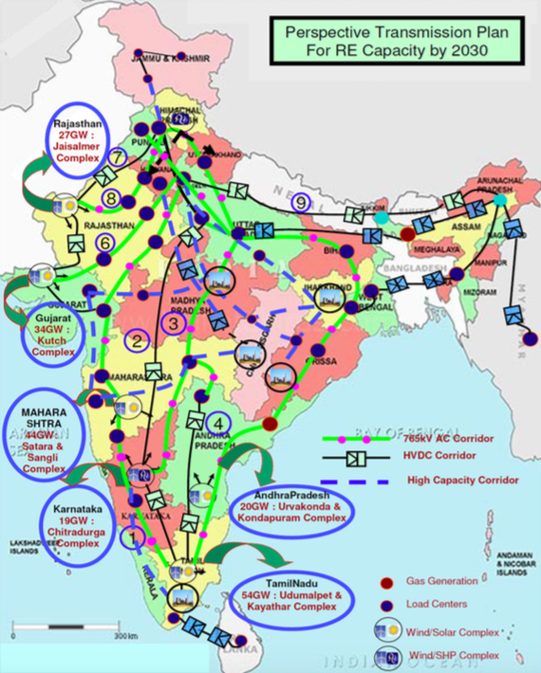
A: Green Energy Corridors
Green Energy Corridor is a comprehensive scheme for evacuation and integration of RE from large wind and solar farms in 8 RE rich states - Tamil Nadu, Rajasthan, Karnataka, Andhra Pradesh, Maharashtra, Gujarat, Himachal Pradesh and Madhya Pradesh
The first phase of the project includes about approx. 9400 ckm transmission lines and substations of total capacity of approx. 19000 MVA (32.5 GW of RE Plants)
The funding mechanism consists of Viability Gap Funding (VGF) of 40% of the project cost from Government of India
Second Phase is presently under implementation
Green Energy
Corridors

Slide 12
A: Renewable Energy Management Centers (REMC)
Objectives and Benefits
State of the Art modelling tools for accurate RE generation forecasts integrated with weather forecasting inputs
RE scheduling with secure interfaces for Grid Operators, Regulators and RE Generators; maximize RE utilization and help utilities meet Renewable energy Purchase Obligations (RPO)
System-wide visibility and improved operational coordination; visualization and evaluation of RE forecast performance
Architecture
4 Regional REMCs (Northern, Southern, Western and Eastern) and a National REMC – these are integrated with the Regional Load Dispatch Centers (RLDCs) and the National Load Dispatch Centre (NLDC)
Supports Grid Operators to ensure coordination with conventional resources to achieve lower operational costs
Manage reliability challenges through curtailment and modification of RE schedules during constrained conditions

Slide 13
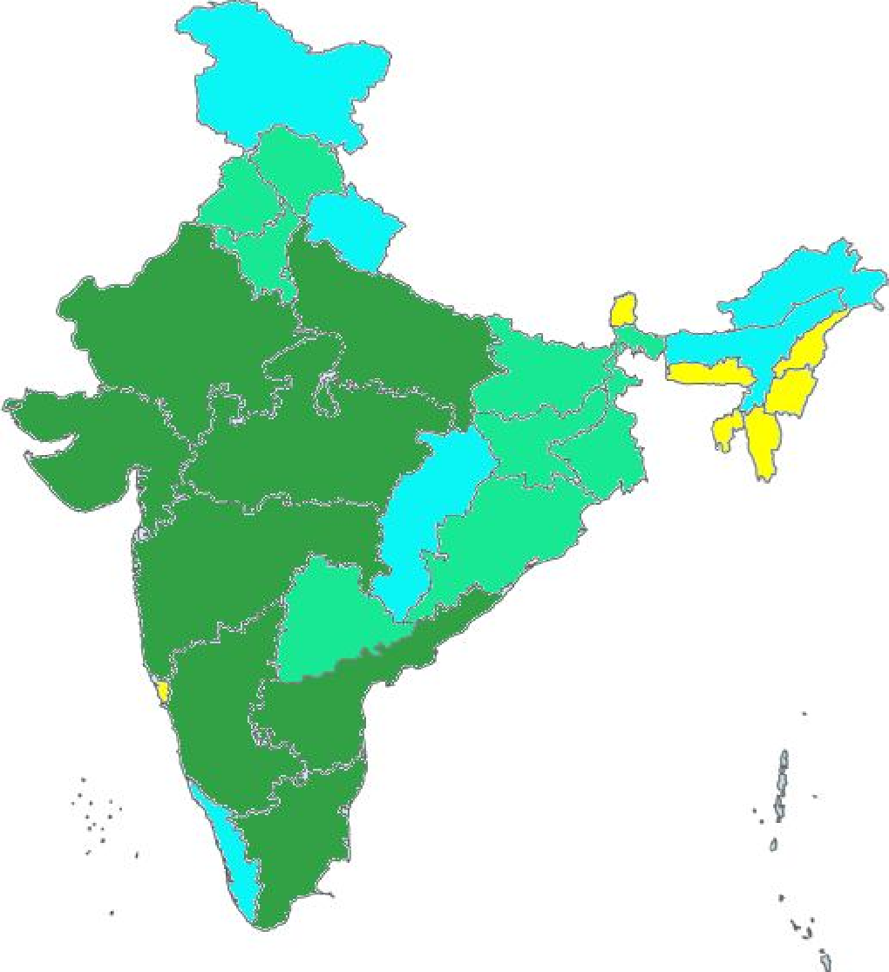
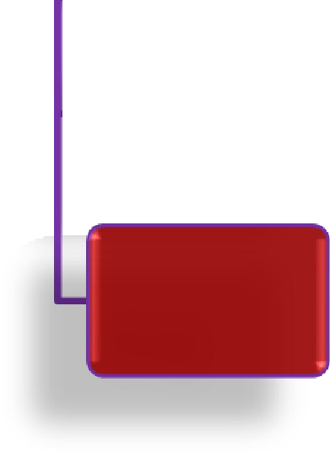
REMC – Phase 1
NLDC
Phase 2: REMCs in 6 States and one Region under implementation
NRLDC
WRLDC
SRLDC
NRLDC
Rajasthan
NL DC
Raj
MP
TN
Gujarat
MP
Maharashtra
Guj
AP
WRLDC
Mah
Kar
Karnataka
SRLDC
TN
AP
Phase 1: REMCs in 7 States, 3 Regions and National Level (11 REMCs) for US$ 62 Million – completed

Slide 14
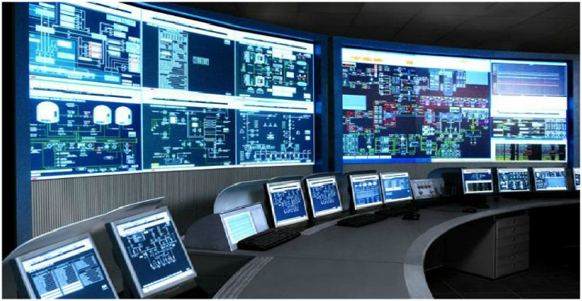
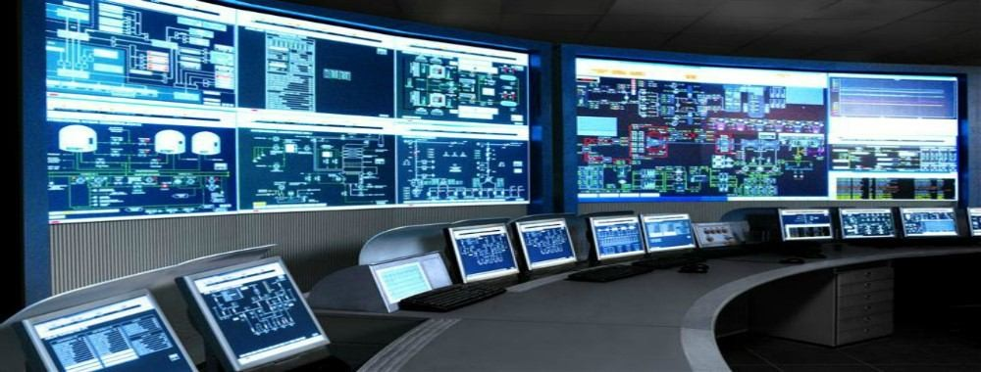
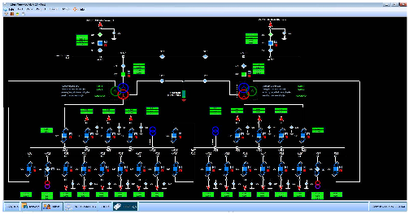
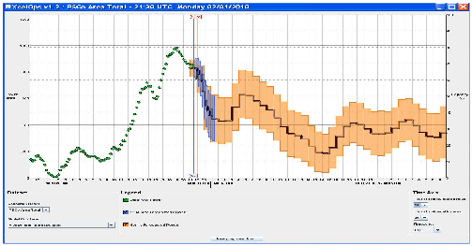
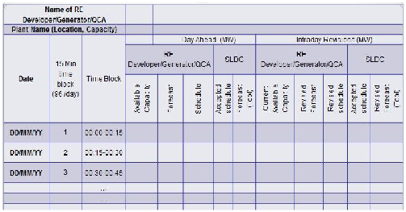
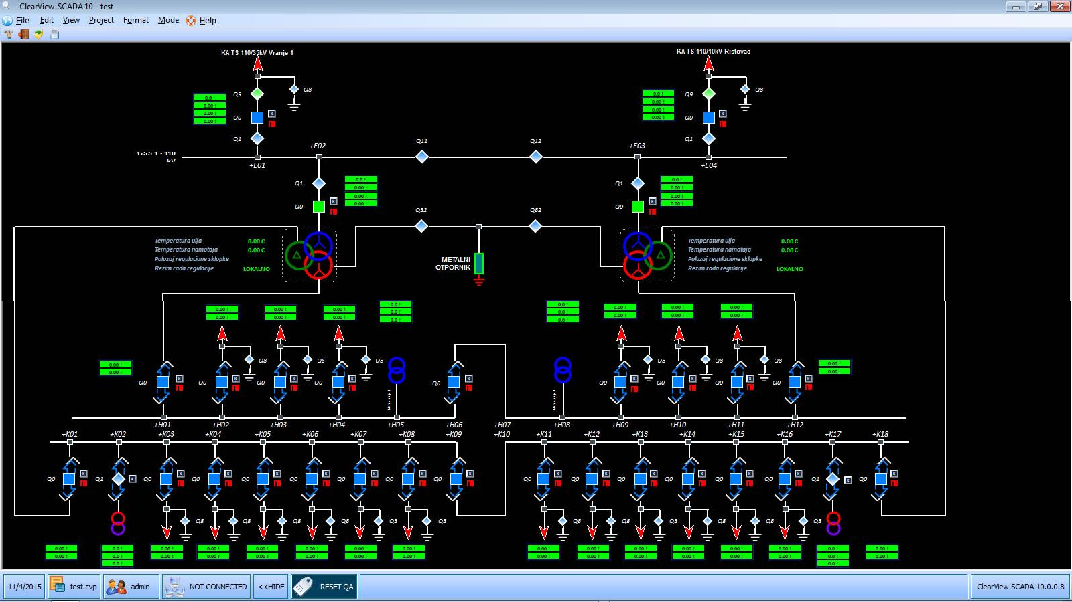
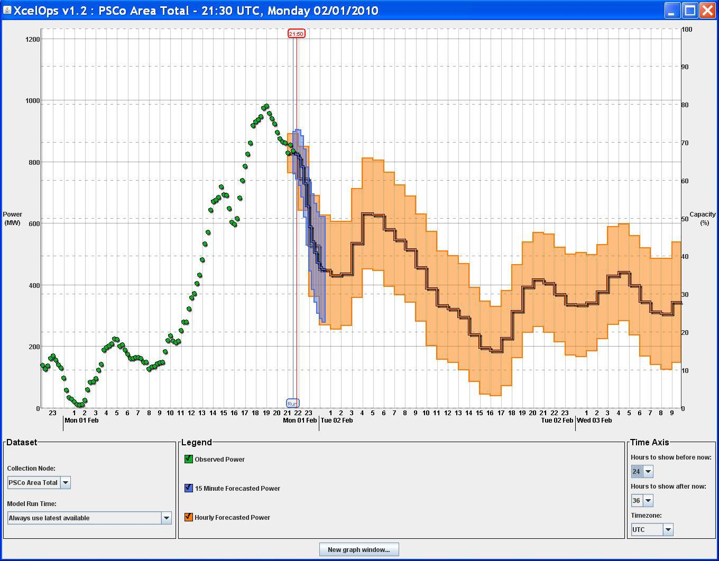
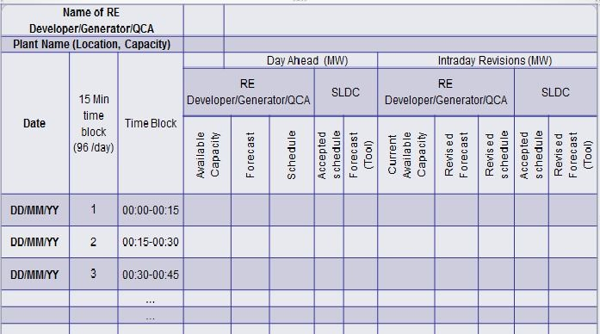
REMC Scope and Main Modules
Forecasting of RE generation on very short term (15 mins), day-ahead, intra-day and week-ahead basis
Real time tracking of generation from RE sources and its geo-spatial visualization
Scheduling solutions for private RE project developers
Close coordination with respective SLDCs for RE generation and control for smooth grid operation
Single source information repository and coordination point for RE penetration (static /dynamic data)
REMC
SCADA
Forecasting Tool
Scheduling Tool

Slide 15
REMC Architecture
WSP
REMC
FSP1
FSP2
Forecasting Tool
RE
Developer
FSP3
RE Schedule
RE Scheduling Tool
Conventional Scheduling Application
REMC SCADA
ICCP
SLDC SCADA
ICCP
DIU
RLDC REMC SCADA
FSP- Forecast service provider (power); WSP: Weather service provider

Slide 16
Features of RE Forecasting Tool
Data Exchange
Share Static, Historical and Real Time SCADA data with Forecast Service Providers (FSPs)
Collect Power forecast from different FSPs as well as Internal Fx tool
Transfer of power forecasts to scheduling Tool
Historical data from repository
Analytics Module
Accuracy Analysis of power forecasts which has implication on payments terms – performance based payments
Performance based retentions terms for FSPs (after two years)

Slide 17
RE Forecasting Tool
SCADA generation data
WSP
Public view
Internal Forecast module
Visualisation Analytics & Reporting
FSP1
Forecast combination & Aggregation module
FSP2
RE
Scheduling Tool
FSP3
Forecasting Tool
Repository

Slide 18
A: Round The Clock RE Power
RE Developers to Setup ESS to Supply 24x7 RE Power to Buyers
Solar Energy Corporation of India awarded several such projects in last 2 years
Project Developers are setting up pumped-hydro storage or BESS
First project expected to be completed in 2024
Round The Clock (RTC) Power from RE Plants

Slide 19
B: Distributed Energy Storage Systems
Replacement of DG sets with BESS is the fastest and cheapest route to build flexibility for the Indian grid
Over 80 GW of large-size DG sets in India
Diesel at INR 95/liter, DG set will cost >INR 30/kWh
Power from BESS will be INR 15.40/kWh
Ban DG sets for standby power in new buildings
Promote District Cooling Systems (DCS) - more than half the electricity consumption in a building is for space cooling
Instead of each building having their centralized air-conditioning plant (or room-ACs)
DCS are successfully implemented around the world (including GIFT City in Gujarat, India); and built with Thermal Energy Storage that can add Flexibility to the Distribution Grid
ISGF White Paper on DG Replacement with Lithium-Ion Batteries in Commercial Buildings – www.indiasmartgrid.org
ISGF White Paper on Sustainable Air Conditioning with District Cooling Systems - – www.indiasmartgrid.org
Distributed Energy Storage Systems (ESS)
Diesel Generator (DG) set replacement with BESS
District Cooling Systems (DCS) with Thermal Energy Storage

Slide 20
B: Ancillary Services and Demand Response
Demand Response and Ancillary Services
Ancillary Services Regulations at transmission levels is in place – need to bring it to distribution grid
Business models for Demand Response need to be worked out

Slide 21
B: Time of Use (TOU) Tariff
Time of Use (TOU) Tariff for Electricity
Time of Use (ToU) Tariffs are real-time pricing for electricity based on supply-demand scenario in real-time
Price signals are communicated to the participating customers in advance about the Rebate or Surcharge in different time-blocks on the following day so that customers can adjust their interruptible loads accordingly
ISGF prepared TOU Tariff Framework for Gujarat in 2020 – www.indiasmartgrid.org
ISGF conducted a Pilot Demonstration Project in Lucknow with 50 customers (22 MW load) during 2022 - 2023

Slide 22
B: Rooftop Solar Registry
Solar Rooftop PV Systems
Registry Platform and Real-Time Monitoring
Static Data
Dynamic Data
Real-Time Generation
Geographical Mapping
Installed Plant Capacity
Performanace Analysis
National Rooftop Solar Registry – required for forecasting, scheduling and dispatch of Rooftop Solar Generation

Slide 23
B: Smart Inverters
Smart Inverters – IEEE 1547:2018 compliant
Mandating Smart Inverters for all DERs
IEEE 1547:2018 standard compliant smart inverters have following functionalities:
Remote Monitoring and Control
Voltage Ride‐Through and Dynamic Voltage Support
Frequency Ride‐Through and Frequency Support
Start‐Up Ramp Rate
Bureau of Indian Standards to adapt IEEE 1547-2018 soon

Slide 24
B: EV- Grid Integration
EV-Grid integration - Vehicle-to-Grid (V2G) technologies
Virtual Power Plants (VPPs)
Promotion of RE for EV charging
EV-Grid Integration
Both EVs and Rooftop PV (RTPV) are connected to the low-voltage (LV) grid
V2G: Grid connected EVs can mitigate the variability of RTPV generation during the day as well as store surplus generation in the EV batteries and pump back to the grid during peak hours
VPP: Large number of EVs connected to the grid can be aggregated as virtual power plants (VPP)
Promotion of RE for EV Charging through innovative business models to decarbonize the transport sector

Slide 25
B: Grid Interactive Buildings/ Campuses/Smart Appliances
Grid Interactive Buildings and Campuses - Smart Microgrids
Smart Appliances
Smart “grid-connected” microgrids: Large building and campuses to be made Grid-interactive with islanding features to provide flexibility to the main grid
Buildings and Campuses with RTPV, BESS (instead of DG sets for standby power), and EVs with V2G capability
Microgrids can buy (green) electricity from the grid at the cheapest rates and store it in the BESS and EVs and use it during peak hours or even sell it back to the grid at higher prices
Smart Appliances: All electrical equipment and appliances should be made smart and grid interactive; Ban production and sale of inefficient equipment and appliances in a phased manner

Slide 26
B: Dynamic RE Markets and P2P Trading of Green Energy
Peer-to-Peer (P2P) Trading on Blockchain Platforms
Dynamic RE Markets
Peer-to-Peer (P2P) Trading: Prosumers with RTPV systems can sell their surplus electricity to others who wish to buy GREEN ELECTRICITY – this can be done efficiently on blockchain platforms
ISGF implemented 3 pilot projects (Lucknow, Delhi and Kolkata) on P2P trading of solar energy on blockchain
Uttar Pradesh Electricity Regulatory Commission has issued detailed regulation for P2P Trading of Rooftop Solar Energy in April 2023 – first of its kind globally
Delhi Electricity Regulatory Commission has issued Draft Regulations in June 2023
Promotion of Dynamic RE Markets - where those obligated to offset Scope 2 Emissions can buy green energy

Slide 27
B: Redesign of the Grid
Comprehensive planning and re-design of the electrical network for the evolving “green grid of the 21st century”
Comprehensive planning and re-design of the electrical network – both transmission and distribution grids
Present architecture of transmission and distribution grids is based on the concepts of: “one-way flow of electricity” and “electricity cannot be stored”
Why planning and re-design?
Distributed Energy Resources (DER) that are intermittent and connected to the low-voltage grid
Bi-directional energy flows - Prosumers
Transfer of RE power to major load centers
Energy storage systems (ESS)
EV-Grid Integration

Slide 28
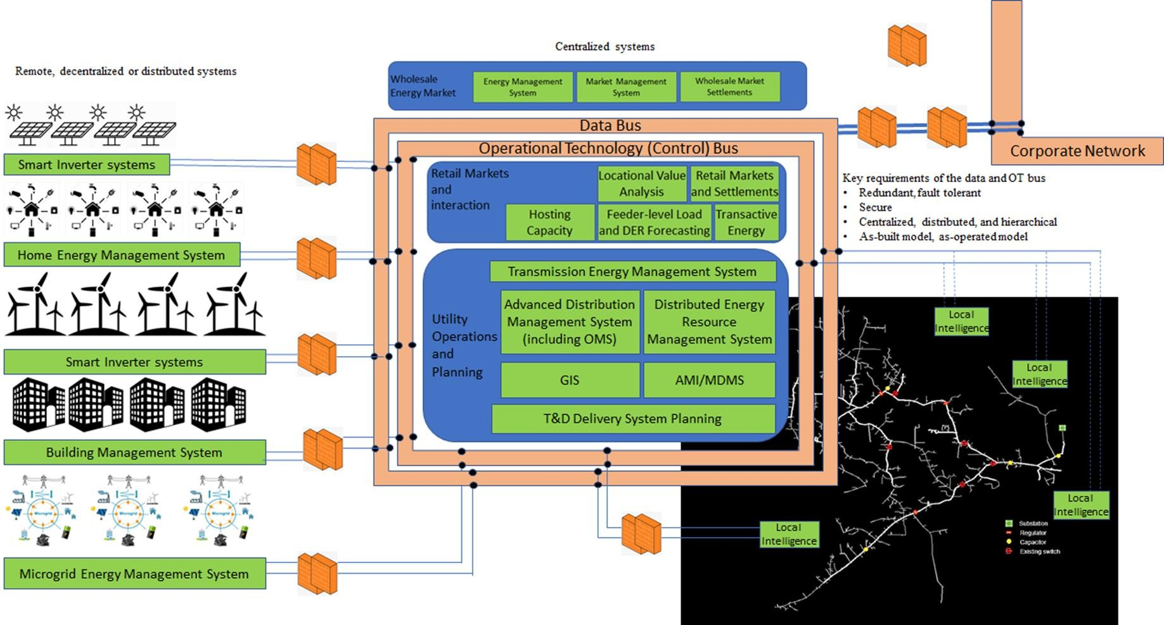
A Logical Architectural Construct of the Future Grid

Slide 29
India (and China) Brings Volumes to the Benefit of Whole World!
Mobile Phone: in 1995 – US$ 1000; today smart phones available at <US$50
Solar PV: In 2011 – US$ 0.40/kWh; today it is US$0.03/kWh
LED Lamps: 2014 – US$5 for a 7W lamp; today <US$1 for a 9W lamp
Smart Meters: 2015 - >US$100/meter; today US$ 50/meter – we are yet to start roll outs!
Volumes offered by a market of >1.4 billion people brings benefits to rest of the 7 billion in the world!

Slide 30
Thank you!
REJI KUMAAR PILLAI
www.rejikumar.com
reji@rejikumar.com x @rejipillai
India Smart Grid Forum
CBIP Building, Malcha Marg, Chanakyapuri, Delhi-110021
www.indiasmartgrid.org
Global Smart Energy Federation
www.globalsmartenergy.org
Follow us at:
X - @IndiaSmartGridF
Facebook - @IndiaSmartGridF
LinkedIn - India Smart Grid Forum (ISGF)

