Slide 1
re
Promoting sustainable energy interconnection:
Opportunities in Asia-Pacific and collaboration with GEIDCO
Connecting a Net zero future: Grid Interconnection and Energy
Collaboration in Asia Pacific
Matthew Wittenstein
Chief of Section, Energy Connectivity, ESCAP

Slide 2
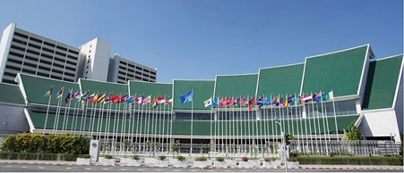
The Economic and Social Commission for Asia and the Pacific
The Commission promotes cooperation among its 53 member States and 9 associate members
The ESCAP secretariat supports inclusive, resilient and sustainable development by generating action-oriented knowledge, and by providing technical assistance and capacity-building services
ESCAP building, Bangkok, Thailand
The ESCAP secretariat supports countries in achievement of national development objectives and the implementation of the 2030 Agenda for Sustainable Development

Slide 3
Asia-Pacific is a main driver of global GHG emissions
Greenhouse gas emissions trends in the Asia-Pacific region compared to the rest of the world, 1990–2020 (GtCO2e)
Sources: Intergovernmental Panel on Climate Change, AR6 Synthesis Report: Climate Change 2023 (2022). Available at www.ipcc ch/ report/sixth-assessment-report-cycle/; and European Commission, “Historical emissions data”, Emissions Database for Global Atmospheric Research. Available at https://zenodo.org/record/5566761#.ZABspXZBzIW.

Slide 4
Two implications of the energy transition
End-use electrification
1. Growing importance of grids and connectivity
2. Shift from fossil to minerals-intensive energy systems
Transition to RE-dominated power systems

Slide 5
Grid investments: required vs trend
Source: World Energy Investment 2023 (IEA, 2023)

Slide 6
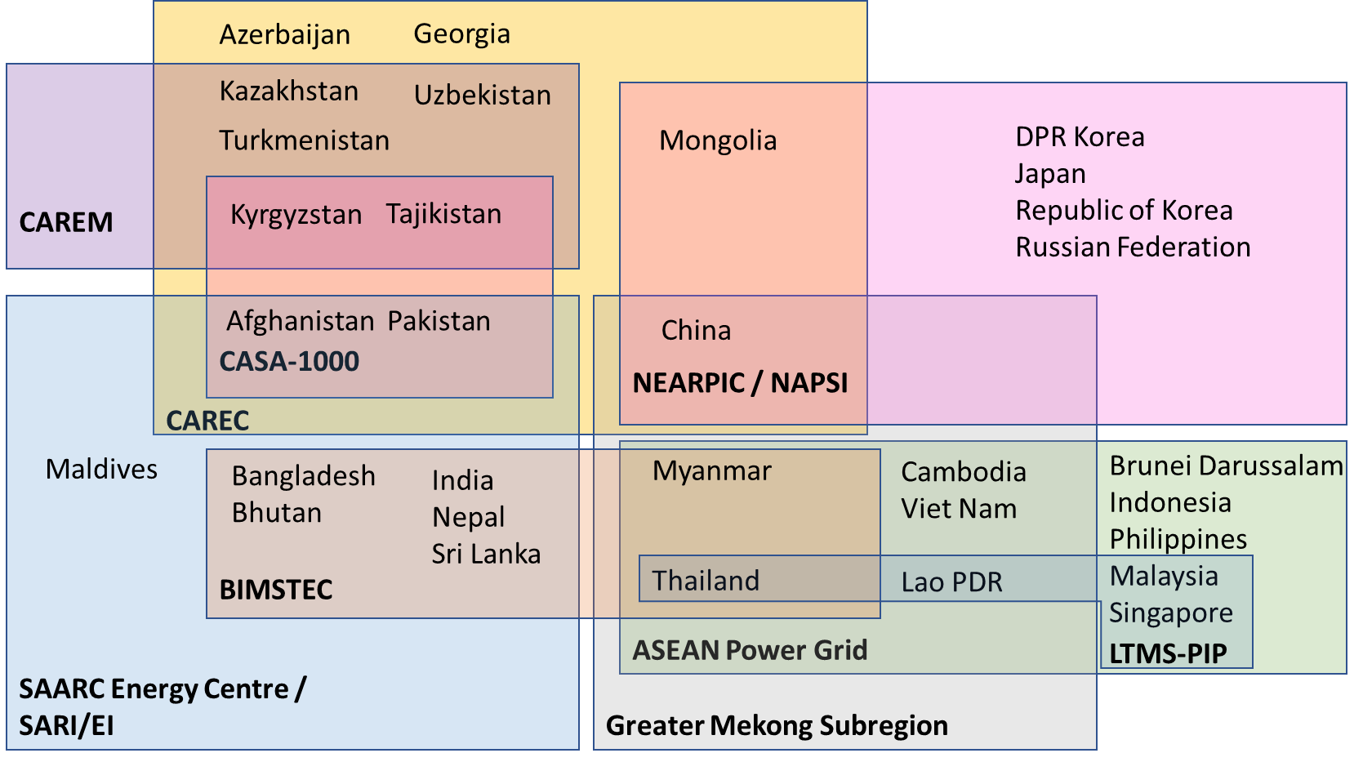
Connectivity initiatives in Asia
Many power system connectivity initiatives in Asia-Pacific, mostly subregional.
Grid infrastructure development and power trading mainly bilateral.
Political will and enabling institutions are the key drivers of connectivity initiatives at subregional level.
No common approach to grid planning or harmonized vision for power system connectivity at regional level.

Slide 7
Regional Road Map on Power System Connectivity
Vision, principles and nine strategies to enable sustainable connectivity
Planning
Develop a regional master plan (Strategy 2)
Financing and development
Mobilize investment in cross-border infrastructure (Strategy 7)
Operations
Move toward multilateral trading and competitive markets (Strategy 5)
Cross-cutting
Co-ordinate cross-border system operations (Strategy 6)
Build trust and political consensus (Strategy 1)
Develop intergovernmental agreements (Strategy 3)
Build capacity and share information, data, best practices (strategy 8)
Ensure coherence of connectivity with the SDGs (Strategy 9)
Coordinate cross-border transmission planning (Strategy 6)
Coordinate, harmonize, and institutionalize policy and reg frameworks (Strategy 4)

Slide 8
Areas of collaboration: ESCAP and GEIDCO
Building off our joint research on ASEAN Energy Interconnection, and under the ESCAP-GEIDCO MOU, a number of areas of collaboration are possible to implement Road Map strategies, e.g.:
Strategy 1: Building trust and political consensus (meetings and analysis)
Strategy 2: Grid mapping
Strategy 8: Build capacity and share information, data, best practices
Strategy 9: Align connectivity initiatives with sustainable development

Slide 9
Strategy 2: Grid mapping on the AP Energy Portal
https://asiapacificenergy.org/

Slide 10
Strategy 9: Green Power Corridor Framework
GPC Framework
Metrics
Building Blocks
Principles
The GPC Framework aims to provide
Practical and relevant principles to guide the development of connectivity initiatives
Building blocks to structure and orient connectivity initiatives
A set of metrics to enable the measurement of connectivity projects against relevant criteria (in development)
GEIDCO’s Global Energy Interconnection Development Index (GEIDI) will be an important reference
Notes:
Strategy nine of the regional road map on power system connectivity focuses on the need to align connectivity with sustainable development. While there are many relevant efforts to increase connectivity across our region, often the primary focus is is on economic energy Security benefits sustainability however is increasingly a driver of cross-border power system integration.
To help countries align power system connectivity efforts with sustainable development ESCAP is developing what we call the green power corridor framework. The framework contains a set of practical and relevant principles to guide development of connectivity initiatives and help align them with sustainable development, a set of building blocks to help structure and orient connectivity efforts, and a set of metrics to enable the measurement of connectivity projects against relevant sustainability criteria
We are still developing this framework and plan to launch it at the Asia Pacific energy forum which will be held in October.

